Slide 1
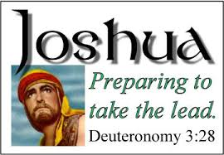
The Call to Courage

Slide 2
Deuteronomy 31:7-8
7. “Then Moses summoned Joshua and said to him in the sight of all Israel, “Be strong and courageous, for you shall go with this people into the land that the Lord has sworn to their fathers to give them, and you shall put them in possession of it.
8. It is the Lord who goes before you. He will be with you; He will not leave you or forsake you. Do not fear or be dismayed.”

