Slide 1

Notes:
Next steps…

Slide 2

Suffering in context…
Without Christ
Saved by Christ
In heaven with Christ
Alone in our
sin & suffering
Helped through our sin
& suffering
Released from sin
& suffering
Ephesians 2:12b
“You lived in this world without God and without hope.”
James 5:13
“Are any of you suffering hardship? You should pray.”
Revelation 21:4
“He will wipe away every tear from their eyes, and there will be no more death or sorrow or crying or pain.”
Notes:
Next steps…

Slide 3
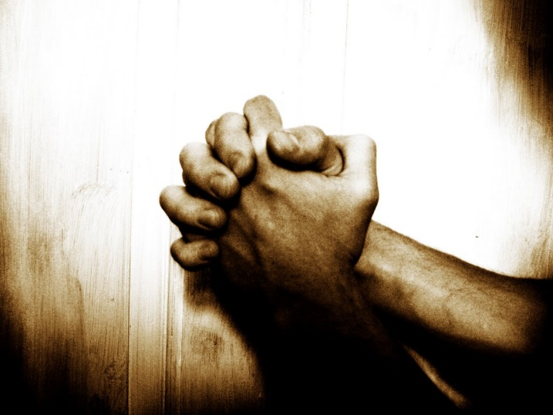
Prayer…
James 5:16-18
“¹⁶Confess your sins to each other and pray for each other so that you may be healed. The earnest prayer of a righteous person has great power and produces wonderful results. ¹⁷Elijah was as human as we are, and yet when he prayed earnestly that no rain would fall, none fell for three and a half years! ¹⁸Then, when he prayed again, the sky sent down rain and the earth began to yield its crops.”
Notes:
Next steps…

Slide 4
A “righteous” man - who qualifies?
Romans 3:10: “No one is righteous— not even one.”
Romans 3:22-24
“We are made right with God by placing our faith in Jesus Christ. And this is true for everyone who believes, no matter who we are. For everyone has sinned; we all fall short of God’s glorious standard. Yet God, in his grace, freely makes us right in his sight. He did this through Christ Jesus when he freed us from the penalty for our sins.”
Notes:
Next steps…

Slide 5
Are we earnest in our prayers?
Luke 11:5-10 “Then, teaching them more about prayer, he used this story: “Suppose you went to a friend’s house at midnight, wanting to borrow three loaves of bread. You say to him, ‘A friend of mine has just arrived for a visit, and I have nothing for him to eat.’ And suppose he calls out from his bedroom, ‘Don’t bother me. The door is locked for the night, and my family and I are all in bed. I can’t help you.’ But I tell you this—though he won’t do it for friendship’s sake, if you keep knocking long enough, he will get up and give you whatever you need because of your shameless persistence. “And so I tell you, keep on asking, and you will receive what you ask for. Keep on seeking, and you will find. Keep on knocking, and the door will be opened to you. For everyone who asks, receives. Everyone who seeks, finds. And to everyone who knocks, the door will be opened.”
Notes:
Next steps…

Slide 6
The example of Elijah
James 5:17-18
“¹⁷Elijah was as human as we are, and yet when he prayed earnestly that no rain would fall, none fell for three and a half years! ¹⁸Then, when he prayed again, the sky sent down rain and the earth began to yield its crops.”
Notes:
Next steps…

Slide 7
The importance of close and accountable relationships
James 5:16a “Confess your sins to each other and pray for each other so that you may be healed.”
Romans 8:1 “So now there is no condemnation for those who belong to Christ Jesus.”
Notes:
Next steps…

Slide 8


In Summary…
Our prayer life reflects our faith! If we really want God to act, we need to be earnest in our prayers
We’re called to relate intimately and authentically with other believers
“For each one to relate authentically, and to intentionally pursue God, and His purposes, together”
Notes:
Next steps…

